Slide 1

Web Site Evaluation
and Usability Testing
8-<number>

Slide 2
The focus of this chapter is on several learning objectives
How color can affect a customer’s perception of the company and its products
The criteria used in evaluating Web sites
The cookie and its many wonders
What makes a Web site usable?
Ideas about site content and managing Web traffic
Role of the Web site administrator
8-<number>

Slide 3
Characteristics of Lame Web Sites
Encourage customer to click away to competitors site
Keep surfers wondering about the product or service your company provides
Fail to update regularly
Lack anything new, innovative, or attractive to retain the surfer
Waste visitors’ time with tedious forms
Waste homepage space with ugly graphics
8-<number>

Slide 4
Common Mistakes in website
Exclamation points and commas in the wrong place
Misspelled words
Usage errors ( “its” in place of “it’s”)
Pages blotted with text
Promises of things that simply cannot be delivered
Requiring visitors to install hardware or software
Attempting to run the e-business with no reliable or verifiable log to monitor traffic, number of hits etc.
8-<number>

Slide 5
Questions to consider when Evaluating a Web Site
Are any elements placed incorrectly?
Is the information accurate?
Is it current?
Are the topics covered?
Does each topic show a minimum of bias?
Is the information hierarchy properly arranged?
Should the heads that relate to the page be enlarged?
Should the fonts for the headings be made more readable?
8-<number>

Slide 6
Basic Web Site Anatomy
Location! Location! Location!
Structure
Page anatomy
8-<number>

Slide 7
Color and Its Psychological Effects
Site visitor forms a first impression within the first 8 seconds
Color is the most important design element in a Web site
  Old Web browsers can see only 256 colors
  A designer has a 216-color scheme
Color is inherently unstable
Choose colors that are simple and not distracting
Choose colors that reflect your audience’s values and cultural preferences
8-<number>

Slide 8
Choosing a Color
You need to consider your audience
Will colors strain visitors’ eyes?
Soft colors that represent appropriate settings are ideal
Visit
http://www.mariaclaudiacortes.com/
To know more about color
8-<number>

Slide 9
Major Colors and Their Psychological Effects
 | Red | Red is the most emotionally intense color. It is the color of love. It creates attention, but tends to overtake other colors on the page.
 | Blue | Blue is the color of the sky and the ocean—peaceful and calming. It creates an optical impression that objects are farther away than they really are.
 | Green | Nature, health, optimism, good luck. Green is the color of money and has strong associations with finance and economic stability. But it is a mixed bag. It is linked with envy sickness, and decaying food. It does not do well in a global market.
 | Yellow | Cheerful sunny yellow is the first color the eye processes. It is an attention-getter and represent optimism, hope, and precious metals. It tends to be overpowering.
 | Purple | Purple is a complex color and is the hardest color for the human eye to discriminate. It represents spirituality, mystery, intelligence, royalty, luxury, wealth, and sophistication.
8-<number>

Slide 10
Major Colors and Their Psychological Effects (Cont’d)
 | Orange | Orange represents energy, balance, warmth, and vitality. It is a color most detested by Americans. The color has stronger appeal to Europeans and Latinos.
 | Brown | Brown is the color of earth and is quite abundant in nature. It represents reliability, comfort, and endurance. Men more than women tend to prefer brown over other colors.
 | Gray | Intellect, futurism, modesty, sadness, decay. It is the easiest color for the eye to see.
 | White | Purity and innocence, cleanliness, precision, sterility, death. It reproduces freshness and is quite popular at luxury Web sites. It gives the sense of “pristineness.”
 | Black | Power, sexuality, sophistication, death, mystery, fear, unhappiness, elegance. It signifies death and mourning in many Western cultures.
8-<number>

Slide 11
Color and Individual Differences
Web site colors take on different cultural hues
Use a color that is acceptable to various cultures
Blue is the most globally accessible color
Age, class, and gender differences
  Web sites for young children favor brighter, more solid colors
  Men are attracted to cooler colors like blue and green
  Women prefer warmer colors like orange and red
  Research suggests working-class people prefer colors with basic names like blue, red, green
8-<number>

Slide 12
Colors for the Color Blind
Color perception problems are widespread
Color deficiency can occur in any population, economic class, or ethnic group.
Most color-blind people have red-green perception deficiency
Any designer should be aware of the problem
Understand how color deficiency works
Any text on any mixed-color background is inviting trouble
Keep colors bright
8-<number>

Slide 13
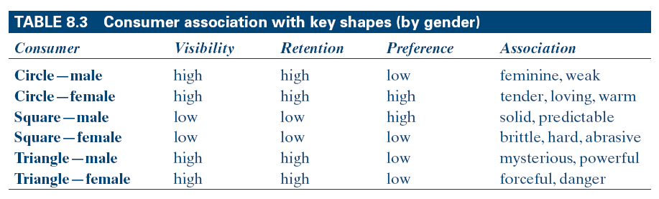
Consumer Association with Key Shapes (by gender)
8-<number>

Slide 14
Site Evaluation Criteria
Color
Shape
Type face
Content
Services Offered
Primary Focus
Ancillaries
Site Classification
Professionalism
Speed
Consistency
Personalization
Security
Scalability
8-<number>

Slide 15
Web Personalization
Allow user to get more information about themselves and their interest
the idea is to tailor web content directly to a specific user by having the user provided information to the web site either directly or through tracking device on the site
Personalization is not a technology. it is a strategy, a marketing tool.
Visitor oriented rather than product oriented
8-<number>

Slide 16
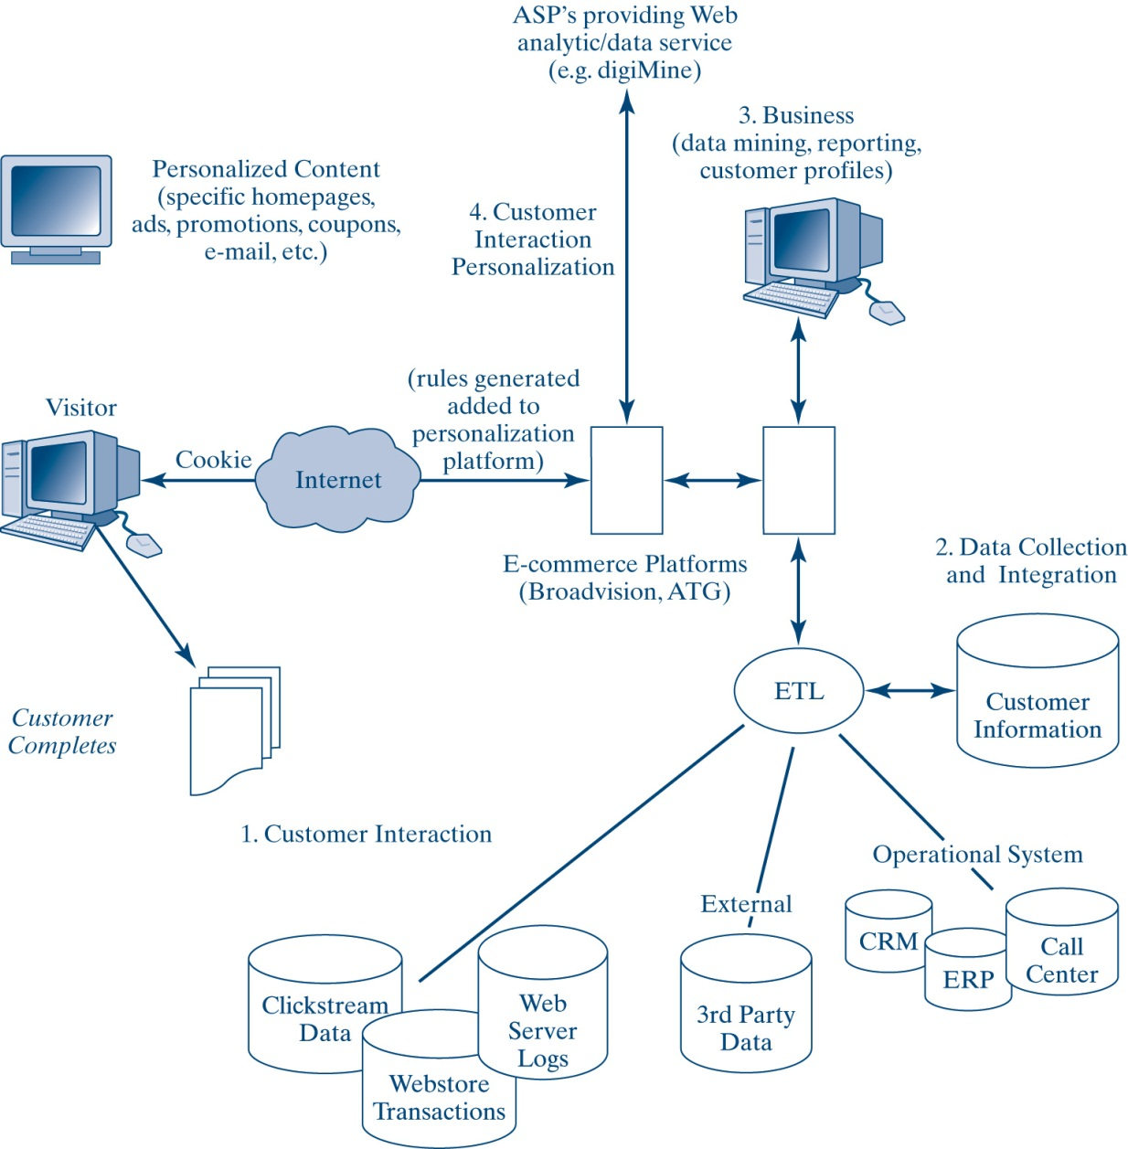
Components of Personalization
8-<number>

Slide 17
Steps to Operationalize Personalization
Customer interaction
Data collection and integration
Business intelligence
Customer interaction personalization
8-<number>

Slide 18
Inference-based Personalization
A technique that tracks a Web user’s behavior, identifies other people with similar behavior, and uses those people to recommend products
Amazon.com
8-<number>

Slide 19
Getting Personal
Personalization vs. Customization
  Personalization is a strategy, a marketing tool, and an art; visitor-oriented rather than product- oriented
  Personalization tries to treat all customers as unique
  Customization focuses on direct user control
  Personalization is driven by artificial software that tries to serve up individualized pages to the user based on a model of that user’s needs (past habits, preferences, and so on).
8-<number>

Slide 20
Approaches to Web Personalization
Cookies
  are bits of code or a text file that sits in a user’s Internet browser memory
  identifies that person to a Web site when they return
Collaborative filtering software
  keeps track of users’ movements across the Web to interpret their interests.
  Analyzes their interests and habits, how long the spend time on a specific page
  compares information about one users behavior against the data gathered against users with similar interest.
8-<number>

Slide 21
Approaches to Web Personalization
Check-box
  users choose specific interests on a checklist so the site can display the requested information
Rule-based personalization
  divides users into segments based on business rules that generate certain types of information from a user’s profile
  ask user to fill a form. which they use to segment user
Neural networks
  use statistical probability algorithms to deliver personalization based on movements such as a visitor’s actions
8-<number>

Slide 22
Do You Want a Cookie?
A cookie is an HTTP header with a text-only string placed in the browser’s memory
The string contains the domain, path, how long it is valid, and the value of a variable that the Web site sets
The original purpose of cookies was to save user’s time
Limitations or cause for concern
  Cookies utilize space on a client’s hard drive for a Web site’s purposes without permission
  They threaten our privacy as Internet users(?)
Cookies can be deleted or rejected at will
8-<number>

Slide 23
Popular Myths About Cookies
Cookies clog the hard disk
Cookies can put a virus on my computer
Cookies give companies access to my personal file
Disabling cookies in my browser will prevent any Web sites from gathering information about me
8-<number>

Slide 24
Web Site Usability
Usability refers to a set of independent quality attributes
  Performance
  Satisfaction
  Ease of navigation
  Learnability
It means an application that allows the user to perform the expected tasks more efficiently
  The integral attributes of a system that affect user performance and productivity
8-<number>

Slide 25
Effective Web Site Design
The goal of effective Web site design is to give users a good experience
  Switching costs on the Internet are low
  Churning is the basic measure of visitor dissatisfaction with a site
http://www.epson.com
http://www.canon.com
http://www.amazon.com
8-<number>

Slide 26
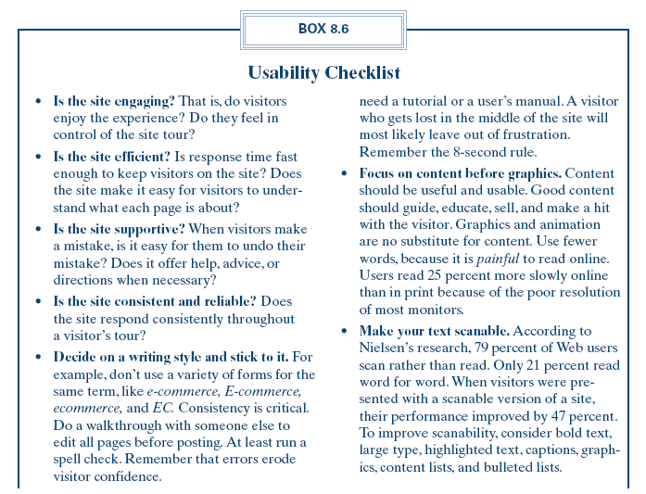
Components of Personalization
8-<number>

Slide 27
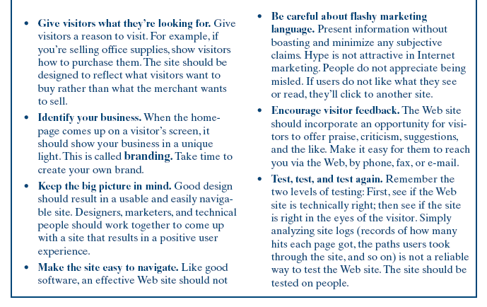
Components of Personalization –(Cont’d)
8-<number>

Slide 28
Reliability Testing
The core of reliability is availability
  System availability
  Network availability
  Application availability
Ensure Web site reliability and usability
  Provide system backup
  Install a disk-mirroring feature
  Ensure that the system hardware is fault-tolerant
  Be sure applications are self-contained
  Be sure there is adequate hard disk space
  Buy everything from a single vendor
8-<number>

Slide 29
User Testing
Determine testing sample
Decide what to look for during the test
Look for trends in the way the site is succeeding or failing to reach others
Any bugs should be relayed and assigned to developer who can fix them
Use Web testing tools
  Load and performance test tools
  Java test tools
  Web site management tools and log analysis tools
8-<number>

Slide 30
Site Performance Issues
Images and color
  Images: GIFs , JPEGs of bitmaps
Readability testing
Caches
How many links?
The role of the Web server
8-<number>

Slide 31
Managing Content and Site Traffic
Content management
Web traffic management
The Web site administrator
  Database server
  Application server(s)
  Web server(s)
  Special-purpose servers for encryption and security checks
  Internet bandwidth
  Internet performance status
8-<number>

Slide 32
Chapter Summary
Web site evaluation
Appropriate site design
Criteria for evaluating Web sites
Approaches to Web personalization
Cookies
A Web site should be as inviting and easy to navigate as possible
User testing
Web content management
Traffic management
Web site management
8-<number>

